Slide 1
CS 7643: Deep Learning
Topics:
Recurrent Neural Networks (RNNs)
BackProp Through Time (BPTT)
Vanishing / Exploding Gradients
Dhruv Batra
Georgia Tech

Slide 2
Administrativia
HW3 + PS3 out
Due 10/28
Last PS and HW
Focus on projects after that

Slide 3
Plan for Today
Model
Recurrent Neural Networks (RNNs)
Learning
BackProp Through Time (BPTT)
Vanishing / Exploding Gradients

Slide 4

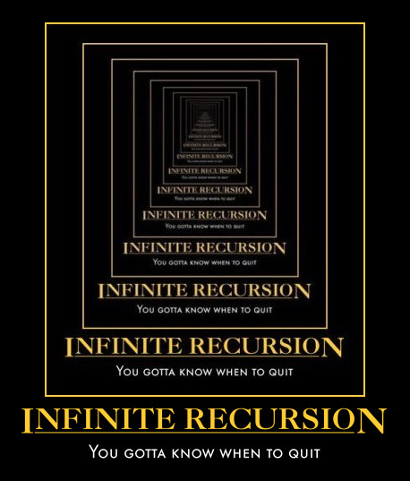
New Topic: RNNs
Image Credit: Andrej Karpathy

Slide 5
Synonyms
Recurrent Neural Networks (RNNs)
Recursive Neural Networks
General family; think graphs instead of chains
Types:
“Vanilla” RNNs
Long Short Term Memory (LSTMs)
Gated Recurrent Units (GRUs)
…
Algorithms
BackProp Through Time (BPTT)
BackProp Through Structure (BPTS)

Slide 6
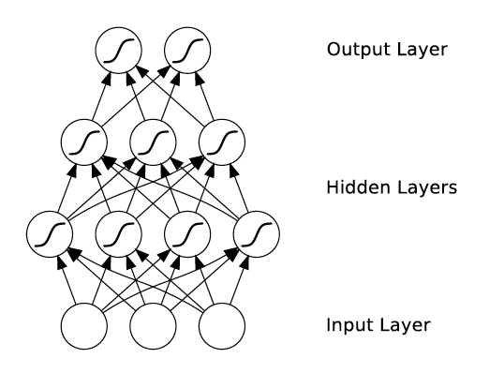
What’s wrong with MLPs?
Problem 1: Can’t model sequences
Fixed-sized Inputs & Outputs
No temporal structure
Problem 2: Pure feed-forward processing
No “memory”, no feedback
Image Credit: Alex Graves, book

Slide 7
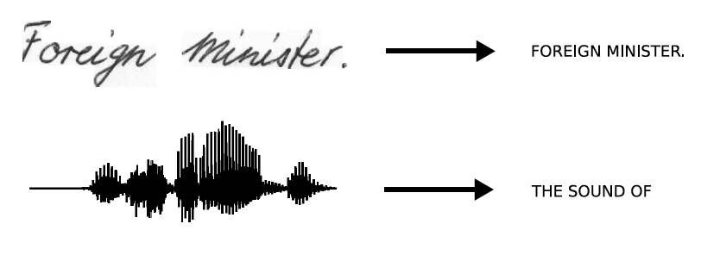
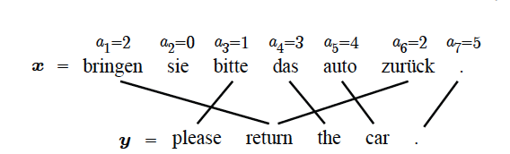
Sequences are everywhere…
Image Credit: Alex Graves and Kevin Gimpel

Slide 8
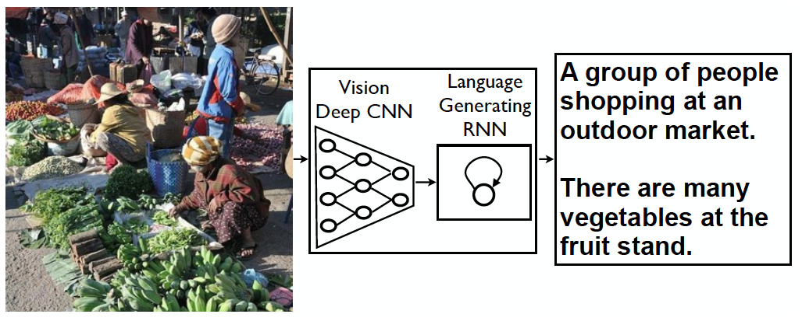
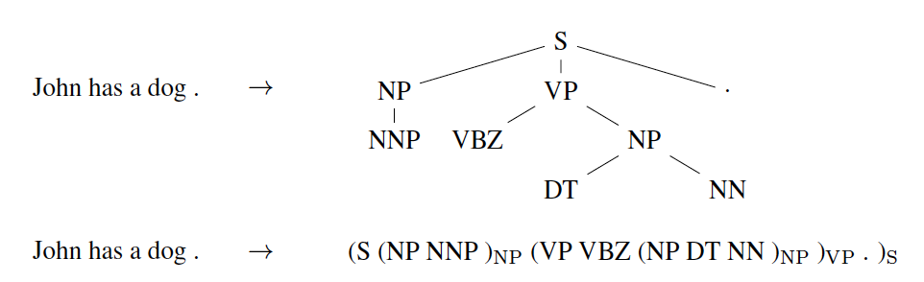
Even where you might not expect a sequence…
Image Credit: Vinyals et al.

Slide 9
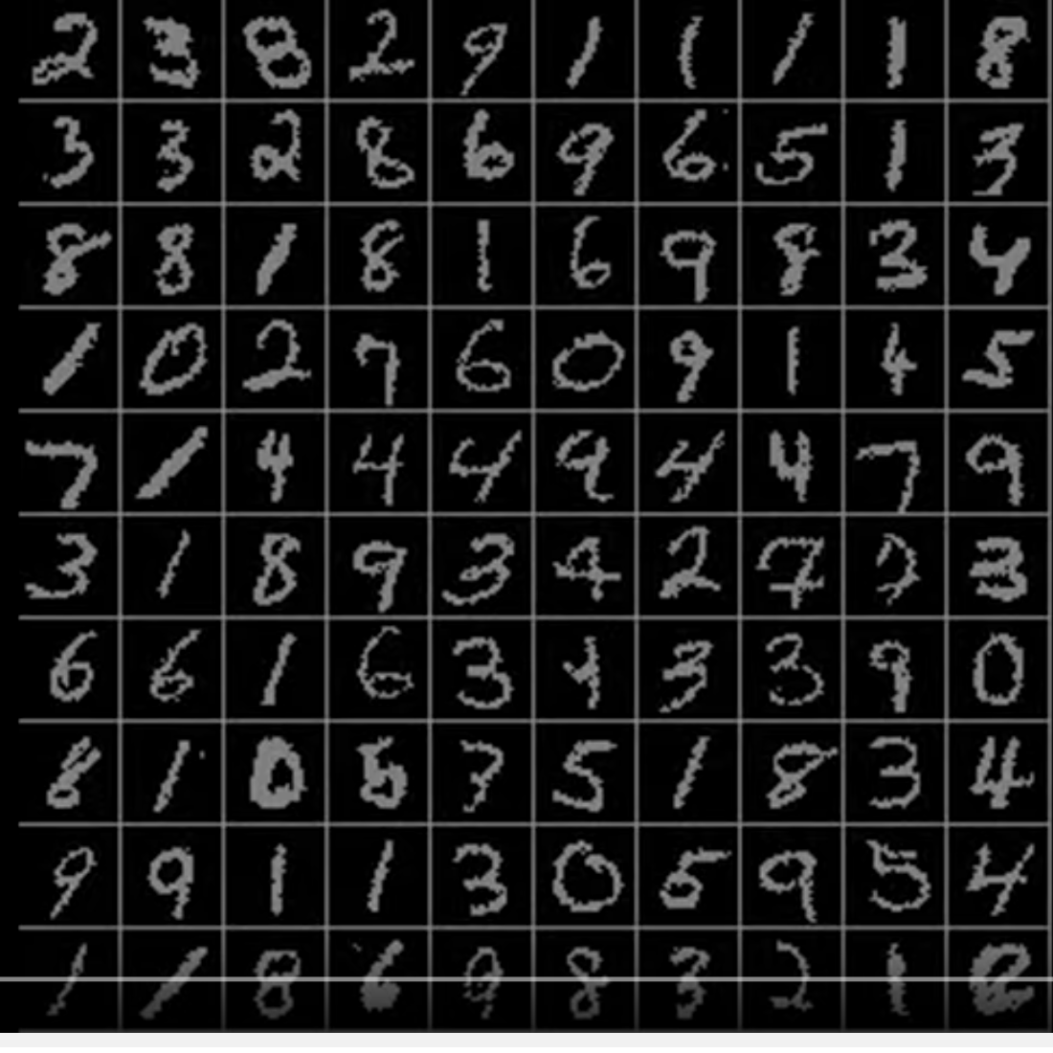
Even where you might not expect a sequence…
Classify images by taking a series of “glimpses”
Ba, Mnih, and Kavukcuoglu, “Multiple Object Recognition with Visual Attention”, ICLR 2015.
Gregor et al, “DRAW: A Recurrent Neural Network For Image Generation”, ICML 2015
Figure copyright Karol Gregor, Ivo Danihelka, Alex Graves, Danilo Jimenez Rezende, and Daan Wierstra, 2015. Reproduced with permission.
Slide Credit: Fei-Fei Li, Justin Johnson, Serena Yeung, CS 231n

Slide 10
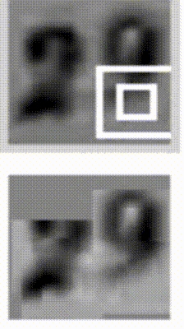
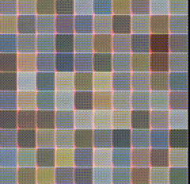
Even where you might not expect a sequence…
Output ordering = sequence
Image Credit: Ba et al.; Gregor et al

Slide 11
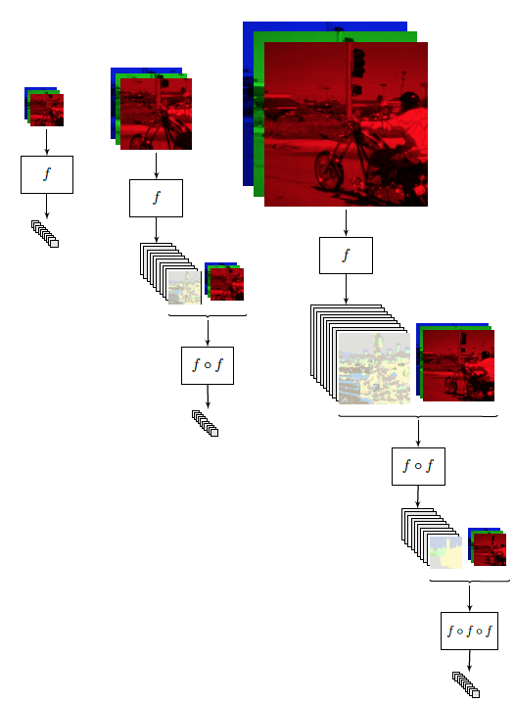
Image Credit: [Pinheiro and Collobert, ICML14]

Slide 12
Why model sequences?
Figure Credit: Carlos Guestrin

Slide 13
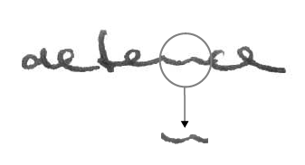
Why model sequences?
Image Credit: Alex Graves

Slide 14
Sequences in Input or Output?
It’s a spectrum…
Input: No sequence
Output: No sequence
Example: “standard” classification / regression problems
Input: No sequence
Output: Sequence
Example: Im2Caption
Input: Sequence
Output: No sequence
Example: sentence classification, multiple-choice question answering
Input: Sequence
Output: Sequence
Example: machine translation, video captioning, open-ended question answering, video question answering
Image Credit: Andrej Karpathy

Slide 15
2 Key Ideas
Parameter Sharing
in computation graphs = adding gradients

Slide 16
Computational Graph
Slide Credit: Marc'Aurelio Ranzato

Slide 18
Gradients add at branches
+
Slide Credit: Fei-Fei Li, Justin Johnson, Serena Yeung, CS 231n
Notes:
Gradients add at branches, from multivariate chain rule
Since wiggling this node affects both connected nodes in the forward pass, then at backprop the upstream gradient coming into this node is the sum of the gradients flowing back from both nodes

Slide 19
Duality in Fprop and Bprop
FPROP
BPROP
SUM
+
COPY
+

Slide 20
2 Key Ideas
Parameter Sharing
in computation graphs = adding gradients
“Unrolling”
in computation graphs with parameter sharing

Slide 21
Name that model
Y₁ = {a,…z}
Y₂ = {a,…z}
Y₃ = {a,…z}
Y₄ = {a,…z}
Y₅ = {a,…z}
X₁ =
X₂ =
X₃ =
X₄ =
X₅ =
Hidden Markov Model (HMM)
Figure Credit: Carlos Guestrin

Slide 22
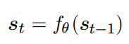
How do we model sequences?
No input
Image Credit: Bengio, Goodfellow, Courville

Slide 23
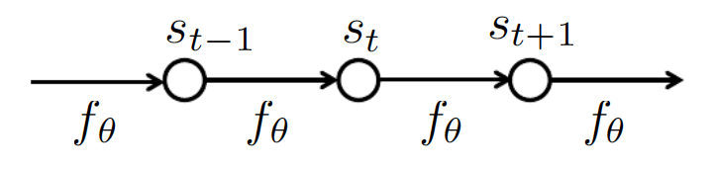
How do we model sequences?
No input
Image Credit: Bengio, Goodfellow, Courville

Slide 24
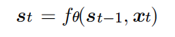
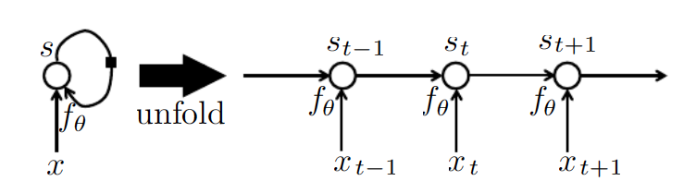
How do we model sequences?
With inputs
Image Credit: Bengio, Goodfellow, Courville

Slide 25
2 Key Ideas
Parameter Sharing
in computation graphs = adding gradients
“Unrolling”
in computation graphs with parameter sharing
Parameter sharing + Unrolling
Allows modeling arbitrary sequence lengths!
Keeps numbers of parameters in check

Slide 26
Recurrent Neural Network
RNN
x
Slide Credit: Fei-Fei Li, Justin Johnson, Serena Yeung, CS 231n

Slide 27
Recurrent Neural Network
y
usually want to predict a vector at some time steps
RNN
x
Slide Credit: Fei-Fei Li, Justin Johnson, Serena Yeung, CS 231n

Slide 28
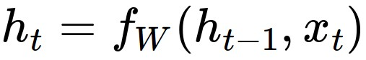
Recurrent Neural Network
We can process a sequence of vectors x by applying a recurrence formula at every time step:
y
RNN
new state
old state
input vector at some time step
some function
with parameters W
x
Slide Credit: Fei-Fei Li, Justin Johnson, Serena Yeung, CS 231n

Slide 29
Recurrent Neural Network
We can process a sequence of vectors x by applying a recurrence formula at every time step:
y
RNN
Notice: the same function and the same set of parameters are used at every time step.
x
Slide Credit: Fei-Fei Li, Justin Johnson, Serena Yeung, CS 231n

Slide 30
(Vanilla) Recurrent Neural Network
The state consists of a single “hidden” vector h:
y
RNN
x
Slide Credit: Fei-Fei Li, Justin Johnson, Serena Yeung, CS 231n

Slide 31
RNN: Computational Graph
h₀
f_{W}
h₁
x₁
Slide Credit: Fei-Fei Li, Justin Johnson, Serena Yeung, CS 231n

Slide 32
RNN: Computational Graph
h₀
f_{W}
h₁
f_{W}
h₂
x₁
x₂
Slide Credit: Fei-Fei Li, Justin Johnson, Serena Yeung, CS 231n

Slide 33
RNN: Computational Graph
h₀
h₁
h₂
h₃
…
h_{T}
f_{W}
f_{W}
f_{W}
x₁
x₂
x₃
Slide Credit: Fei-Fei Li, Justin Johnson, Serena Yeung, CS 231n

Slide 34
RNN: Computational Graph
Re-use the same weight matrix at every time-step
h₀
h₁
h₂
h₃
…
h_{T}
f_{W}
f_{W}
f_{W}
x₁
x₂
x₃
W
Slide Credit: Fei-Fei Li, Justin Johnson, Serena Yeung, CS 231n

Slide 35
RNN: Computational Graph: Many to Many
y₁
y₂
y₃
y_{T}
h₀
h₁
h₂
h₃
…
h_{T}
f_{W}
f_{W}
f_{W}
x₁
x₂
x₃
W
Slide Credit: Fei-Fei Li, Justin Johnson, Serena Yeung, CS 231n

Slide 36
RNN: Computational Graph: Many to Many
y₁
y₂
y₃
y_{T}
L₁
L₂
L₃
L_{T}
h₀
h₁
h₂
h₃
…
h_{T}
f_{W}
f_{W}
f_{W}
x₁
x₂
x₃
W
Slide Credit: Fei-Fei Li, Justin Johnson, Serena Yeung, CS 231n

Slide 37
L
RNN: Computational Graph: Many to Many
y₁
y₂
y₃
y_{T}
L₁
L₂
L₃
L_{T}
h₀
h₁
h₂
h₃
…
h_{T}
f_{W}
f_{W}
f_{W}
x₁
x₂
x₃
W
Slide Credit: Fei-Fei Li, Justin Johnson, Serena Yeung, CS 231n

Slide 38
RNN: Computational Graph: Many to One
y
h₀
h₁
h₂
h₃
…
h_{T}
f_{W}
f_{W}
f_{W}
x₁
x₂
x₃
W
Slide Credit: Fei-Fei Li, Justin Johnson, Serena Yeung, CS 231n

Slide 39
RNN: Computational Graph: One to Many
y₁
y₂
y₃
y_{T}
h₀
h₁
h₂
h₃
…
h_{T}
f_{W}
f_{W}
f_{W}
x
W
Slide Credit: Fei-Fei Li, Justin Johnson, Serena Yeung, CS 231n

Slide 40
Sequence to Sequence: Many-to-one + one-to-many
Many to one: Encode input sequence in a single vector
h₀
f_{W}
h₁
f_{W}
h₂
f_{W}
h₃
…
h_{T}
x₁
x₂
x₃
W₁
Slide Credit: Fei-Fei Li, Justin Johnson, Serena Yeung, CS 231n

Slide 41
Sequence to Sequence: Many-to-one + one-to-many
One to many: Produce output sequence from single input vector
Many to one: Encode input sequence in a single vector
y₁
y₂
h₀
f_{W}
h₁
f_{W}
h₂
f_{W}
h₃
…
h_{T}
h₁
h₂
…
f_{W}
f_{W}
f_{W}
x₁
x₂
x₃
W₁
W₂
Slide Credit: Fei-Fei Li, Justin Johnson, Serena Yeung, CS 231n

Slide 42
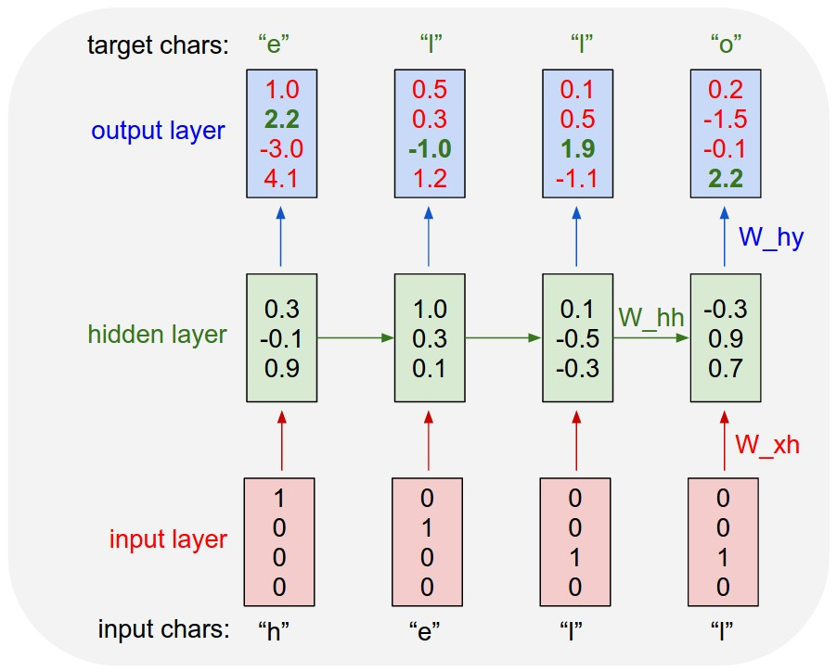
Example: Character-level
Language Model
Vocabulary:
[h,e,l,o]
Example training
sequence:
“hello”
Slide Credit: Fei-Fei Li, Justin Johnson, Serena Yeung, CS 231n

Slide 43
Example: Character-level
Language Model
Vocabulary:
[h,e,l,o]
Example training
sequence:
“hello”
Slide Credit: Fei-Fei Li, Justin Johnson, Serena Yeung, CS 231n

Slide 44
Example: Character-level
Language Model
Vocabulary:
[h,e,l,o]
Example training
sequence:
“hello”
Slide Credit: Fei-Fei Li, Justin Johnson, Serena Yeung, CS 231n

Slide 45
Example: Character-level
Language Model
Sampling
Vocabulary:
[h,e,l,o]
At test-time sample characters one at a time, feed back to model
“e”
“l”
“l”
“o”
Sample
.03
.13
.00
.84
.25
.20
.05
.50
.11
.17
.68
.03
.11
.02.08
.79
Softmax
Slide Credit: Fei-Fei Li, Justin Johnson, Serena Yeung, CS 231n

Slide 46
Example: Character-level
Language Model
Sampling
Vocabulary:
[h,e,l,o]
At test-time sample characters one at a time, feed back to model
“e”
“l”
“l”
“o”
Sample
.03
.13
.00
.84
.25
.20
.05
.50
.11
.17
.68
.03
.11
.02.08
.79
Softmax
Slide Credit: Fei-Fei Li, Justin Johnson, Serena Yeung, CS 231n

Slide 47
Example: Character-level
Language Model
Sampling
Vocabulary:
[h,e,l,o]
At test-time sample characters one at a time, feed back to model
“e”
“l”
“l”
“o”
Sample
.03
.13
.00
.84
.25
.20
.05
.50
.11
.17
.68
.03
.11
.02.08
.79
Softmax
Slide Credit: Fei-Fei Li, Justin Johnson, Serena Yeung, CS 231n

Slide 48
Example: Character-level
Language Model
Sampling
Vocabulary:
[h,e,l,o]
At test-time sample characters one at a time, feed back to model
“e”
“l”
“l”
“o”
Sample
.03
.13
.00
.84
.25
.20
.05
.50
.11
.17
.68
.03
.11
.02.08
.79
Softmax
Slide Credit: Fei-Fei Li, Justin Johnson, Serena Yeung, CS 231n

Slide 49
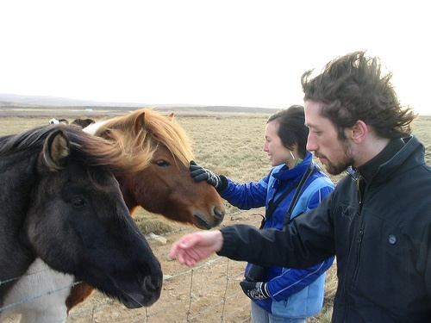
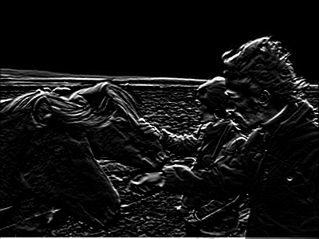
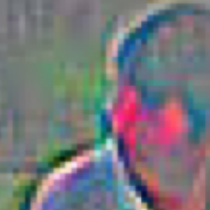
Neural Image Captioning
Image Embedding (VGGNet)
4096-dim
Convolution Layer + Non-Linearity
Pooling Layer
Convolution Layer + Non-Linearity
Pooling Layer
Fully-Connected MLP

Slide 50
Neural Image Captioning
Image Embedding (VGGNet)
4096-dim
Convolution Layer + Non-Linearity
Pooling Layer
Convolution Layer + Non-Linearity
Pooling Layer
Fully-Connected MLP

Slide 51
Neural Image Captioning
P(next)
P(next)
P(next)
P(next)
P(next)
P(next)
Linear
RNN
RNN
RNN
RNN
RNN
RNN
<start>
Two
people
and
two
horses.

Slide 52
Neural Image Captioning
P(next)
P(next)
P(next)
P(next)
P(next)
P(next)
Linear
RNN
RNN
RNN
RNN
RNN
RNN
<start>
Two
people
and
two
horses.

Slide 53
Sequence Model Factor Graph

Slide 54
Beam Search Demo
http://dbs.cloudcv.org/captioning&mode=interactive

Slide 55
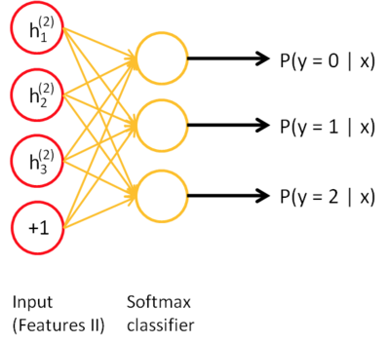
Typical VQA Models
Neural Network Softmax over top K answers
Embedding (VGGNet)
Image
4096-dim
Convolution Layer + Non-Linearity
Pooling Layer
Convolution Layer + Non-Linearity
Pooling Layer
Fully-Connected MLP
Question
Embedding (LSTM)
“How many horses are in this image?”

Slide 56
Forward through entire sequence to compute loss, then backward through entire sequence to compute gradient
Backpropagation through time
Loss
Slide Credit: Fei-Fei Li, Justin Johnson, Serena Yeung, CS 231n

Slide 57
Truncated Backpropagation through time
Loss
Run forward and backward through chunks of the sequence instead of whole sequence
Slide Credit: Fei-Fei Li, Justin Johnson, Serena Yeung, CS 231n

Slide 58
Truncated Backpropagation through time
Loss
Carry hidden states forward in time forever, but only backpropagate for some smaller number of steps
Slide Credit: Fei-Fei Li, Justin Johnson, Serena Yeung, CS 231n

Slide 59
Truncated Backpropagation through time
Loss
Slide Credit: Fei-Fei Li, Justin Johnson, Serena Yeung, CS 231n

Slide 60
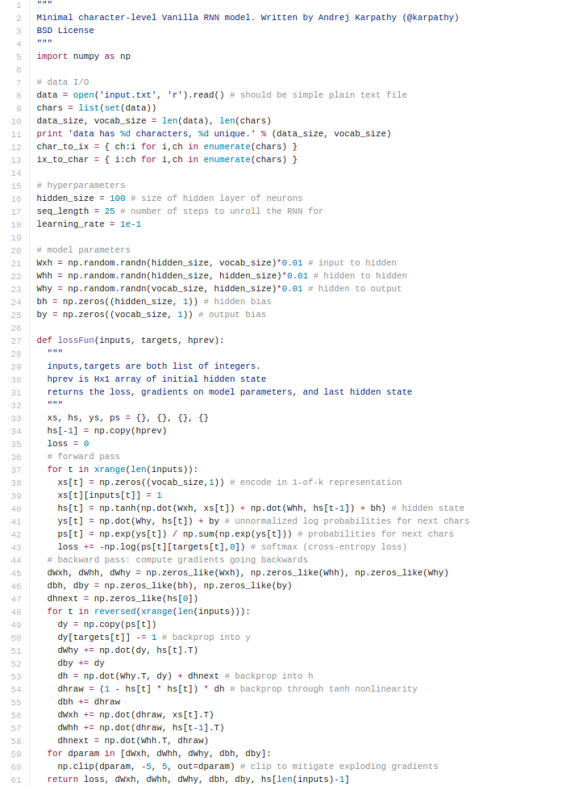
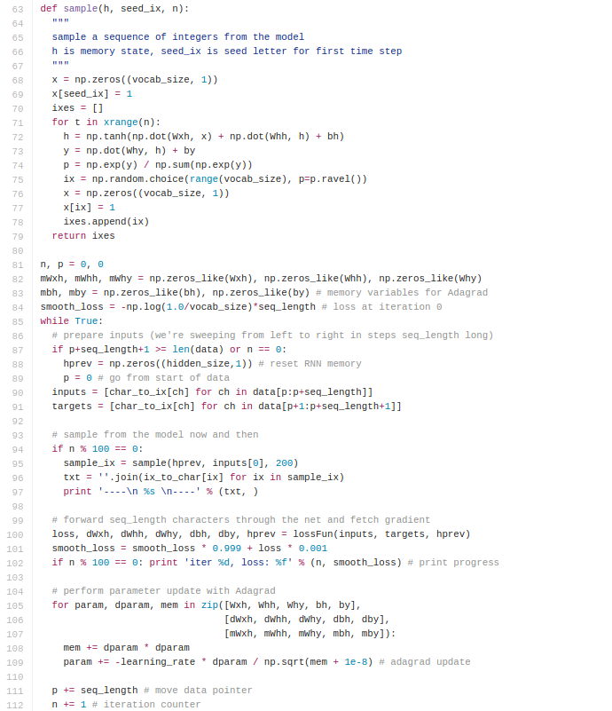
min-char-rnn.py gist: 112 lines of Python
(https://gist.github.com/karpathy/d4dee566867f8291f086)
Slide Credit: Fei-Fei Li, Justin Johnson, Serena Yeung, CS 231n

Slide 61
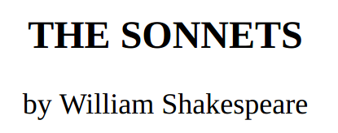
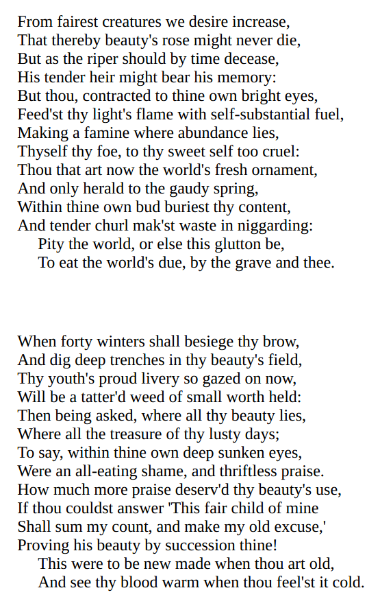
y
RNN
x
Slide Credit: Fei-Fei Li, Justin Johnson, Serena Yeung, CS 231n

Slide 62
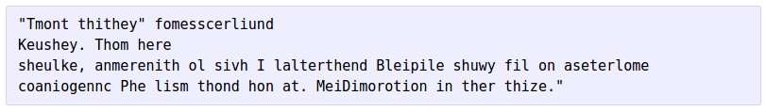
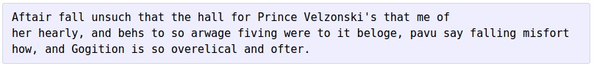
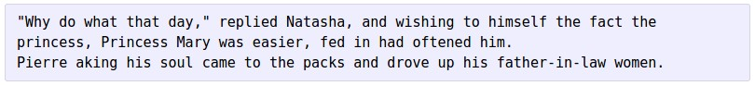
at first:
train more
train more
train more
Slide Credit: Fei-Fei Li, Justin Johnson, Serena Yeung, CS 231n

Slide 63
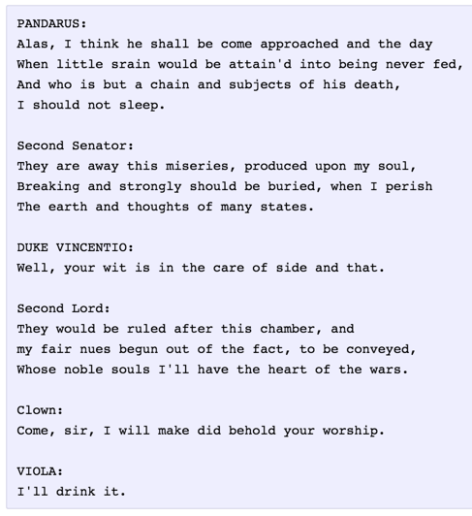
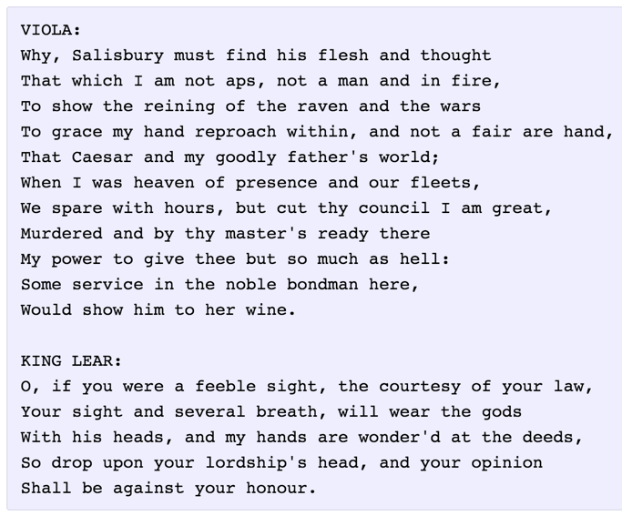
Slide Credit: Fei-Fei Li, Justin Johnson, Serena Yeung, CS 231n

Slide 64
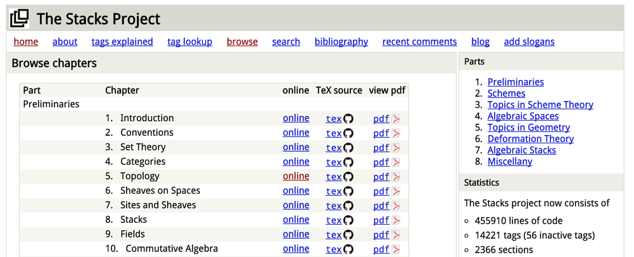
The Stacks Project: open source algebraic geometry textbook
Latex source
http://stacks.math.columbia.edu/
The stacks project is licensed under the GNU Free Documentation License
Slide Credit: Fei-Fei Li, Justin Johnson, Serena Yeung, CS 231n

Slide 65
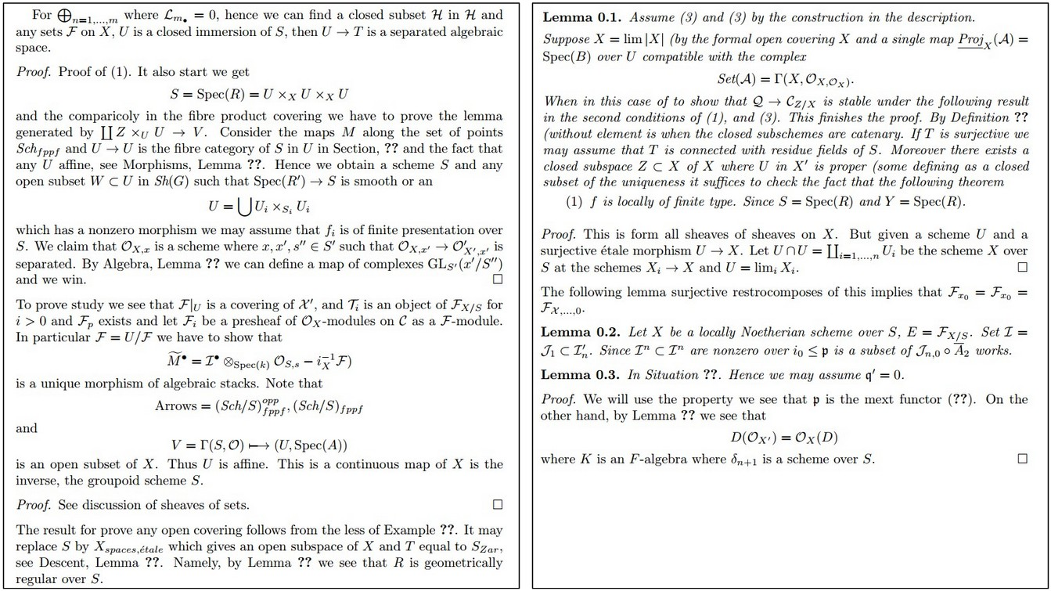
Slide Credit: Fei-Fei Li, Justin Johnson, Serena Yeung, CS 231n

Slide 66
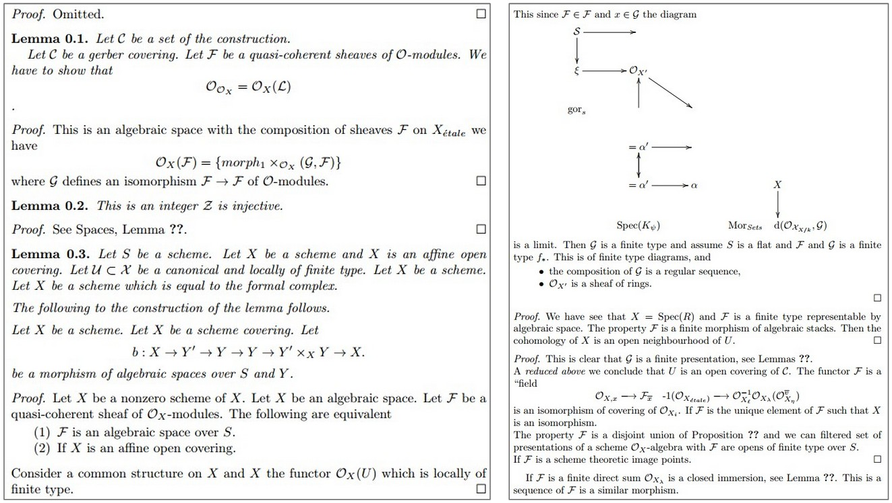
Slide Credit: Fei-Fei Li, Justin Johnson, Serena Yeung, CS 231n

Slide 67
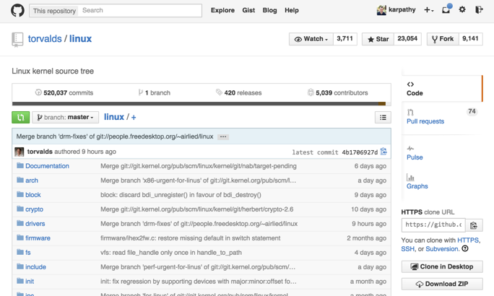
Slide Credit: Fei-Fei Li, Justin Johnson, Serena Yeung, CS 231n

Slide 68
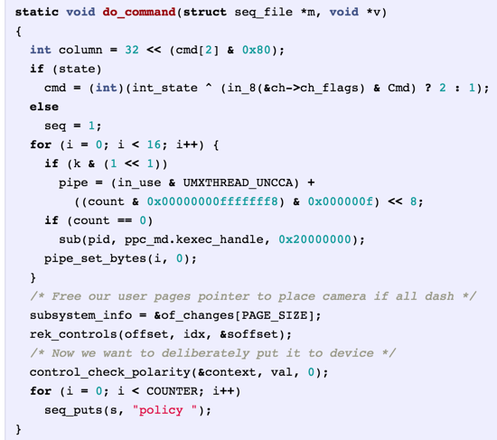
Generated
C code
Slide Credit: Fei-Fei Li, Justin Johnson, Serena Yeung, CS 231n

Slide 69
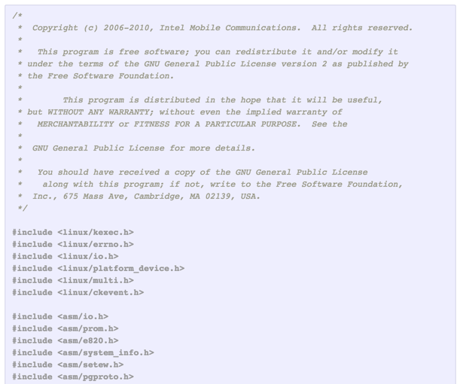
Slide Credit: Fei-Fei Li, Justin Johnson, Serena Yeung, CS 231n

Slide 70
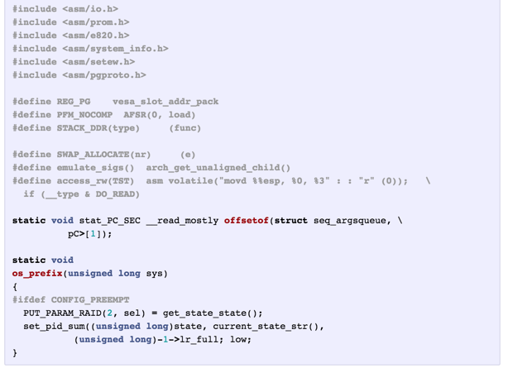
Slide Credit: Fei-Fei Li, Justin Johnson, Serena Yeung, CS 231n

Slide 71
Searching for interpretable cells
Karpathy, Johnson, and Fei-Fei: Visualizing and Understanding Recurrent Networks, ICLR Workshop 2016
Slide Credit: Fei-Fei Li, Justin Johnson, Serena Yeung, CS 231n

Slide 72
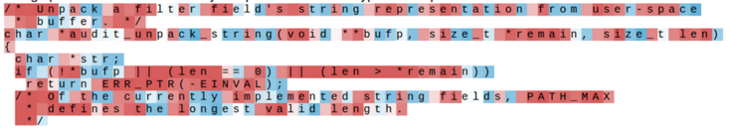
Searching for interpretable cells
Karpathy, Johnson, and Fei-Fei: Visualizing and Understanding Recurrent Networks, ICLR Workshop 2016
Figures copyright Karpathy, Johnson, and Fei-Fei, 2015; reproduced with permission
Slide Credit: Fei-Fei Li, Justin Johnson, Serena Yeung, CS 231n

Slide 73
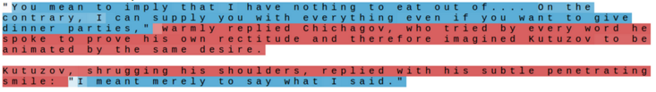
Searching for interpretable cells
quote detection cell
Karpathy, Johnson, and Fei-Fei: Visualizing and Understanding Recurrent Networks, ICLR Workshop 2016
Figures copyright Karpathy, Johnson, and Fei-Fei, 2015; reproduced with permission
Slide Credit: Fei-Fei Li, Justin Johnson, Serena Yeung, CS 231n

Slide 74
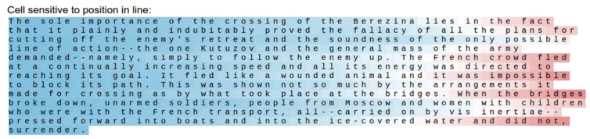
Searching for interpretable cells
line length tracking cell
Karpathy, Johnson, and Fei-Fei: Visualizing and Understanding Recurrent Networks, ICLR Workshop 2016
Figures copyright Karpathy, Johnson, and Fei-Fei, 2015; reproduced with permission
Slide Credit: Fei-Fei Li, Justin Johnson, Serena Yeung, CS 231n

Slide 75
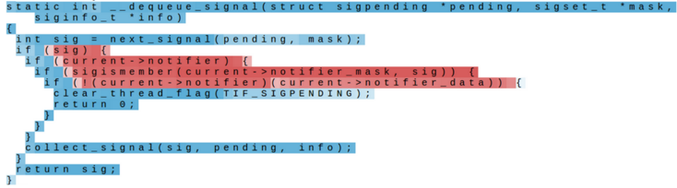
Searching for interpretable cells
if statement cell
Karpathy, Johnson, and Fei-Fei: Visualizing and Understanding Recurrent Networks, ICLR Workshop 2016
Figures copyright Karpathy, Johnson, and Fei-Fei, 2015; reproduced with permission
Slide Credit: Fei-Fei Li, Justin Johnson, Serena Yeung, CS 231n

Slide 76
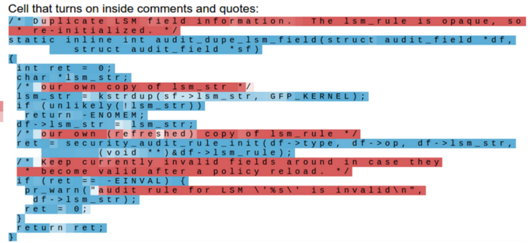
Searching for interpretable cells
quote/comment cell
Karpathy, Johnson, and Fei-Fei: Visualizing and Understanding Recurrent Networks, ICLR Workshop 2016
Figures copyright Karpathy, Johnson, and Fei-Fei, 2015; reproduced with permission
Slide Credit: Fei-Fei Li, Justin Johnson, Serena Yeung, CS 231n

Slide 77
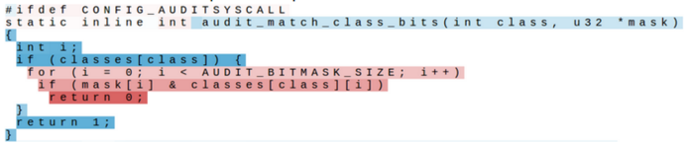
Searching for interpretable cells
code depth cell
Karpathy, Johnson, and Fei-Fei: Visualizing and Understanding Recurrent Networks, ICLR Workshop 2016
Figures copyright Karpathy, Johnson, and Fei-Fei, 2015; reproduced with permission
Slide Credit: Fei-Fei Li, Justin Johnson, Serena Yeung, CS 231n

Slide 78
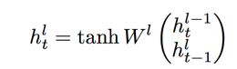
Multilayer RNNs
depth
time
Slide Credit: Fei-Fei Li, Justin Johnson, Serena Yeung, CS 231n

Slide 79
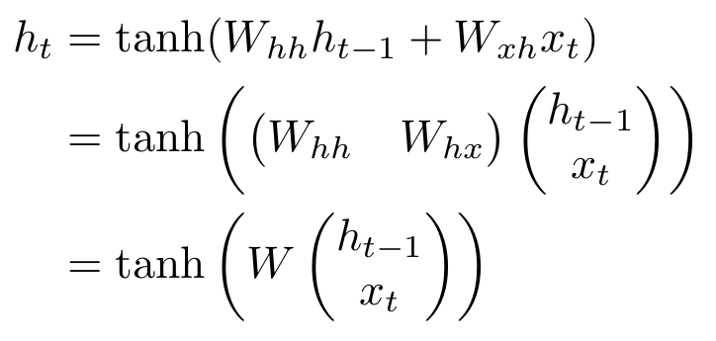
Vanilla RNN Gradient Flow
Bengio et al, “Learning long-term dependencies with gradient descent is difficult”, IEEE Transactions on Neural Networks, 1994
Pascanu et al, “On the difficulty of training recurrent neural networks”, ICML 2013
W
tanh
h_{t-1}
h_{t}
stack
x_{t}
Slide Credit: Fei-Fei Li, Justin Johnson, Serena Yeung, CS 231n

Slide 80
Vanilla RNN Gradient Flow
Bengio et al, “Learning long-term dependencies with gradient descent is difficult”, IEEE Transactions on Neural Networks, 1994
Pascanu et al, “On the difficulty of training recurrent neural networks”, ICML 2013
Backpropagation from h_{t} to h_{t-1} multiplies by W (actually W_{hh}^{T})
W
tanh
h_{t-1}
h_{t}
stack
x_{t}
Slide Credit: Fei-Fei Li, Justin Johnson, Serena Yeung, CS 231n

Slide 81
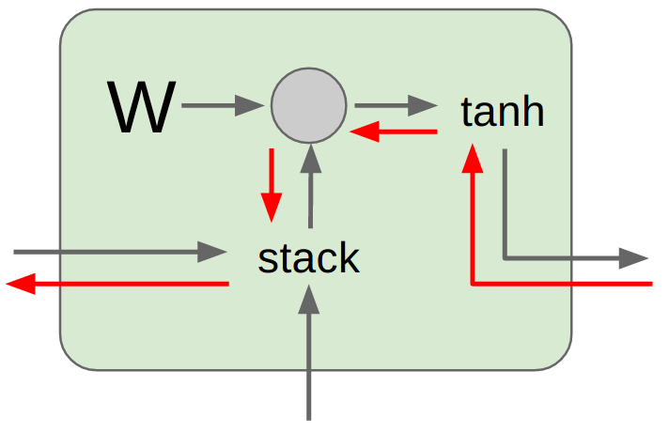
Vanilla RNN Gradient Flow
Bengio et al, “Learning long-term dependencies with gradient descent is difficult”, IEEE Transactions on Neural Networks, 1994
Pascanu et al, “On the difficulty of training recurrent neural networks”, ICML 2013
h₀
h₁
h₂
h₃
h₄
x₁
x₂
x₃
x₄
Computing gradient of h₀ involves many factors of W
(and repeated tanh)
Slide Credit: Fei-Fei Li, Justin Johnson, Serena Yeung, CS 231n

Slide 82
Vanilla RNN Gradient Flow
Bengio et al, “Learning long-term dependencies with gradient descent is difficult”, IEEE Transactions on Neural Networks, 1994
Pascanu et al, “On the difficulty of training recurrent neural networks”, ICML 2013
h₀
h₁
h₂
h₃
h₄
x₁
x₂
x₃
x₄
Largest singular value > 1: Exploding gradients
Largest singular value < 1:
Vanishing gradients
Computing gradient of h₀ involves many factors of W
(and repeated tanh)
Slide Credit: Fei-Fei Li, Justin Johnson, Serena Yeung, CS 231n

Slide 83
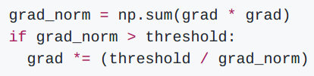
Vanilla RNN Gradient Flow
Bengio et al, “Learning long-term dependencies with gradient descent is difficult”, IEEE Transactions on Neural Networks, 1994
Pascanu et al, “On the difficulty of training recurrent neural networks”, ICML 2013
h₀
h₁
h₂
h₃
h₄
x₁
x₂
x₃
x₄
Largest singular value > 1: Exploding gradients
Largest singular value < 1:
Vanishing gradients
Gradient clipping: Scale gradient if its norm is too big
Computing gradient of h₀ involves many factors of W
(and repeated tanh)
Slide Credit: Fei-Fei Li, Justin Johnson, Serena Yeung, CS 231n

Slide 84
Vanilla RNN Gradient Flow
Bengio et al, “Learning long-term dependencies with gradient descent is difficult”, IEEE Transactions on Neural Networks, 1994
Pascanu et al, “On the difficulty of training recurrent neural networks”, ICML 2013
h₀
h₁
h₂
h₃
h₄
x₁
x₂
x₃
x₄
Largest singular value > 1: Exploding gradients
Largest singular value < 1:
Vanishing gradients
Computing gradient of h₀ involves many factors of W
(and repeated tanh)
Change RNN architecture
Slide Credit: Fei-Fei Li, Justin Johnson, Serena Yeung, CS 231n

Slide 85
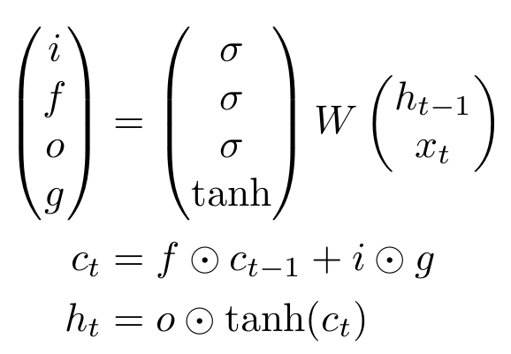
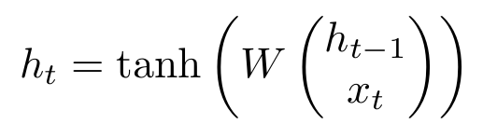
Long Short Term Memory (LSTM)
Vanilla RNN
LSTM
Hochreiter and Schmidhuber, “Long Short Term Memory”, Neural Computation 1997
Slide Credit: Fei-Fei Li, Justin Johnson, Serena Yeung, CS 231n

Slide 86
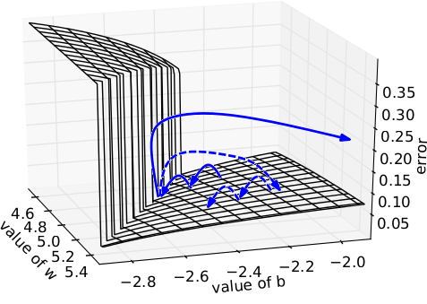
Illustration [Pascanu et al]
Intuition
Error surface of a single hidden unit RNN; High curvature walls
Solid lines: standard gradient descent trajectories
Dashed lines: gradient rescaled to fix problem

Slide 87

Fix #1
Pseudocode
Image Credit: Richard Socher

Slide 88

Fix #2
Smart Initialization and ReLus
[Socher et al 2013]
A Simple Way to Initialize Recurrent Networks of Rectified Linear Units, Le et al. 2015

Slide 89


Meet LSTMs
Image Credit: Christopher Olah (http://colah.github.io/posts/2015-08-Understanding-LSTMs/)

Slide 90

LSTMs Intuition: Memory
Cell State / Memory
Image Credit: Christopher Olah (http://colah.github.io/posts/2015-08-Understanding-LSTMs/)

Slide 91

LSTMs Intuition: Forget Gate
Should we continue to remember this “bit” of information or not?
Image Credit: Christopher Olah (http://colah.github.io/posts/2015-08-Understanding-LSTMs/)

Slide 92

LSTMs Intuition: Input Gate
Should we update this “bit” of information or not?
If so, with what?
Image Credit: Christopher Olah (http://colah.github.io/posts/2015-08-Understanding-LSTMs/)

Slide 93

LSTMs Intuition: Memory Update
Forget that + memorize this
Image Credit: Christopher Olah (http://colah.github.io/posts/2015-08-Understanding-LSTMs/)

Slide 94

LSTMs Intuition: Output Gate
Should we output this “bit” of information to “deeper” layers?
Image Credit: Christopher Olah (http://colah.github.io/posts/2015-08-Understanding-LSTMs/)

Slide 95
LSTMs Intuition: Additive Updates
Backpropagation from c_{t} to c_{t-1} only elementwise multiplication by f, no matrix multiply by W
Image Credit: Christopher Olah (http://colah.github.io/posts/2015-08-Understanding-LSTMs/)

Slide 96
LSTMs Intuition: Additive Updates
Uninterrupted gradient flow!
Image Credit: Christopher Olah (http://colah.github.io/posts/2015-08-Understanding-LSTMs/)

Slide 97
LSTMs Intuition: Additive Updates
Uninterrupted gradient flow!
Similar to ResNet!
3x3 conv, 128
...
3x3 conv, 128
3x3 conv, 128
3x3 conv, 64
3x3 conv, 128
3x3 conv, 64
3x3 conv, 64
7x7 conv, 64 / 2
3x3 conv, 64
FC 1000
3x3 conv, 128 / 2
3x3 conv, 128
3x3 conv, 64
3x3 conv, 64
3x3 conv, 64
Pool
3x3 conv, 64
3x3 conv, 64
Input
3x3 conv, 64
3x3 conv, 64
3x3 conv, 64
Pool
Softmax
Image Credit: Christopher Olah (http://colah.github.io/posts/2015-08-Understanding-LSTMs/)

Slide 98
LSTMs
A pretty sophisticated cell
Image Credit: Christopher Olah (http://colah.github.io/posts/2015-08-Understanding-LSTMs/)

Slide 99

LSTM Variants #1: Peephole Connections
Let gates see the cell state / memory
Image Credit: Christopher Olah (http://colah.github.io/posts/2015-08-Understanding-LSTMs/)

Slide 100

LSTM Variants #2: Coupled Gates
Only memorize new if forgetting old
Image Credit: Christopher Olah (http://colah.github.io/posts/2015-08-Understanding-LSTMs/)

Slide 101

LSTM Variants #3: Gated Recurrent Units
Changes:
No explicit memory; memory = hidden output
Z = memorize new and forget old
Image Credit: Christopher Olah (http://colah.github.io/posts/2015-08-Understanding-LSTMs/)

